Slide 1
Exploratory Data Analysis
Investigating 1990s Movies on Netflix

Slide 2
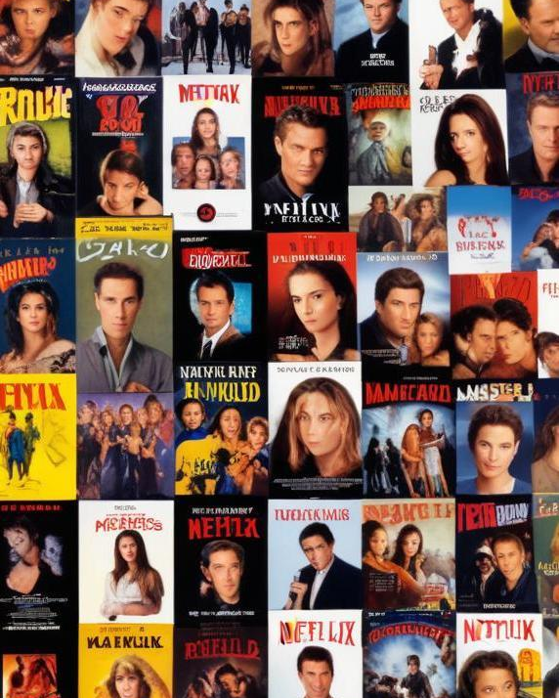
Introduction
This presentation explores Netflix's origins and the analysis of 1990s movies available on the platform, focusing on movie durations and trends.

Slide 3
01
Netflix Overview

Slide 4
History of Netflix
Founded in 1997 as a DVD rental service, Netflix introduced subscription-based rentals, disrupting traditional video rental stores. It began streaming services in 2007 and has since expanded globally, producing original content.

Slide 5
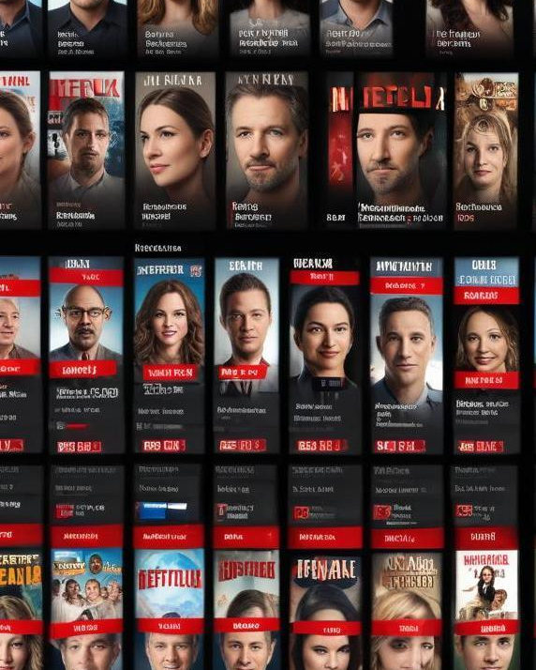
Business Model Evolution
Netflix's business model evolved from DVD rentals to streaming subscriptions, further transitioning into content production. This shift allowed them to dominate the streaming industry by appealing directly to consumer preferences.

Slide 6
Growth into Media Industry
Netflix's growth into the media industry involved significant investments in original content, leading to the creation of popular series and movies. By producing their own content, Netflix has positioned itself as a key player in the entertainment sector, challenging traditional networks and studios.

Slide 7
02
1990s Movie Analysis

Slide 8
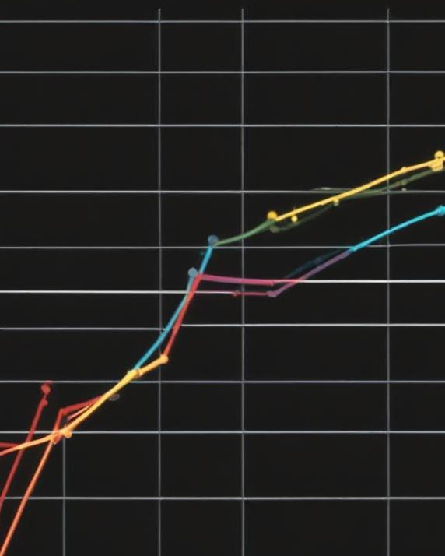
Frequent Movie Duration
In the 1990s, the most frequent movie duration was approximately 94 minutes. This duration reflects the standard length of feature films during that decade, catering to audience preferences and cinematic storytelling techniques of the time.

Slide 9
Short Action Movies Count
In the analysis of 1990s movies, there were 7 short action movies that lasted less than 90 minutes. These films often appealed to audiences seeking quick-paced entertainment and allowed for unique storytelling approaches.

Slide 10
Conclusions
Exploring the Netflix data highlights the significant trends and characteristics of 1990s filmmaking. Understanding these patterns provides valuable insights into the evolution of cinema and viewer preferences.

Slide 11
Thank you!
Do you have any questions?
+91 620 421 838

